Slide 1


The impact of different sources of heterogeneity on loss of accuracy from genomic prediction models July 31, 2018 Joint Statistical Meetings, Vancouver, BC
Levi Waldron
City University of New York
Graduate School of Public Health and Health Policy
www.waldronlab.io
@leviwaldron1
Notes:
Cross-study validation (CSV) of prediction models is an alternative to traditional cross-validation (CV) in domains where multiple comparable datasets are available. Although many studies have noted potential sources of heterogeneity in genomic studies, to our knowledge none have systematically investigated their intertwined impacts on prediction accuracy across studies. We employ a hybrid parametric/non-parametric bootstrap method to realistically simulate publicly available compendia of microarray, RNA-seq, and whole metagenome shotgun (WMS) microbiome studies of health outcomes. We assessed CSV accuracy while manipulating the following types of heterogeneity and combinations of them: 1) prevalence of clinical and pathological covariates, 2) differences in predictor covariance as could arise from batch effects, and 3) differences in the ``true'' model predicting outcome. The most easily identifiable sources of study heterogeneity are consistently not the primary ones that undermine the ability to accurately replicate the accuracy of omics prediction models in new studies. Unidentified heterogeneity, such as could arise from unmeasured confounding, may be more important.

Slide 2
Outline
Background
Cross-validation vs. cross-study validation
Generalist vs. specialist prediction algorithms
Why is cross-study validation disappointing?
Future outlook
Notes:
Abstract: Public databases such as the Gene Expression Omnibus now provide an almost overwhelming free resource for developing and
validating models of association between tumor gene expression and patient outcome in cancer. More than a million gene expression
profiles are available, covering most disease types and study designs. These resources are challenging to utilize due to their unstructured
nature and the potential for unknown sources of heterogeneity between studies. In this talk I will discuss building smaller curated
databases for answering focused research questions, and how experimental and cohort heterogeneity between independent studies can
be identified and leveraged as an advantage for finding robust, generalizable prediction models and biomarkers. I will discuss
"cross-study validation" using all possible combinations of training and validation sets, and show how it can lead to different model
selection and estimations of future prediction performance than traditional cross-validation, and how it can identify outlier studies
and potential sources of heterogeneity.

Slide 3
A note on reproducibility, etc.
 |  | Data
 |  | Same | Different
Code | Same | Reproducible | Replicable
 | Different | Robust | Generalizable
Whitaker, Kirstie (2017): Publishing a reproducible paper.
https://doi.org/10.6084/m9.figshare.4720996.v1

Slide 4
Introduction
Cross-validation etc. are the standard way to
estimate prediction accuracy for the “population” the sample was drawn from
rank supervised learning algorithms
avoid over-optimistic accuracy estimates caused by ‘re-substitution’

Slide 5
What is the population? Is our sample biased?
Clinical samples use available patients
Are those patients representative of the population of interest?
Do the laboratory procedures introduce bias?
How do these biases impact estimation of prediction accuracy?
Is algorithm performance replicable in new datasets?

Slide 6
Cross-study validation specialist and generalist algorithms
What constitutes a good learning algorithm?
A “specialist” that performs well when trained and applied to a single population and experimental setting?
A “generalist” that is sub-optimal for the training population, but performs reasonably well across different populations and experimental setting ?

Slide 7
These questions can be addressed through cross-study validation
Multiple independent datasets available
“Leave-one-in” and “Leave-one-out” matrices of validation statistics
Dataset #
 | 1 | 2 | 3 | 4 | 5
1 | TRAIN | TEST | TEST | TEST | TEST
2 | TEST | TRAIN | TEST | TEST | TEST
3 | TEST | TEST | TRAIN | TEST | TEST
4 | TEST | TEST | TEST | TRAIN | TEST
5 | TEST | TEST | TEST | TEST | TRAIN
Iteration #
Waldron L et al. JNCI J Natl Cancer Inst 2014; DOI:10.1093/jnci/dju049
Riester M. et al. JNCI J Natl Cancer Inst 2014; DOI: 10.1093/jnci/dju048
Ganzfried B. et al. DATABASE 2014; DOI: 10.1093/database/bat013
Notes:
We were interested not just in assessing fully-specified prediction algorithms, but the genes used by those algorithms. Sometimes all we care about are the predictions, but often, a lot of effort goes into thinking hard about those genes and coming up with a biological explanation of why they work so well in this prediction algorithm. But the fact is, there are situations where you can make OK predictions from random gene sets, so the objective here was to use all the datasets for independent validation and assess these gene signatures. So the procedure was:
Summarize prognostic quality of a gene list by its average C-statistic for off-diagonal elements in this matrix of validation statistics

Slide 8
Simulating realistic ensembles of independent datasets
Fit a “true model” to each of i=1, …, I datasets, including clinical covariates
For b= 1, ... ,B= 1000 iterations:
re-sample I datasets with replacement
re-sample N patients with replacement from each
simulate outcome labels from “true model”
With Giovanni Parmigiani and Lorenzo Trippa
Bernau, C. et al. Cross-study validation for the assessment of prediction algorithms.
Bioinformatics 30, i105–i112 (2014).
https://www.bioconductor.org/packages/simulatorZ/ - Maintainer: Yuqing Zhang

Slide 9
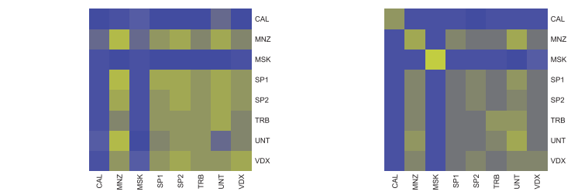
Hybrid parametric / non-parametric bootstrap procedure
Experimental data
Simulated data
8 independent
breast cancer
studies
“Z-matrix”
Bernau, C. et al. Cross-study validation for the assessment of prediction algorithms.
Bioinformatics 30, i105–i112 (2014).
https://www.bioconductor.org/packages/simulatorZ/ - Maintainer: Yuqing Zhang

Slide 10
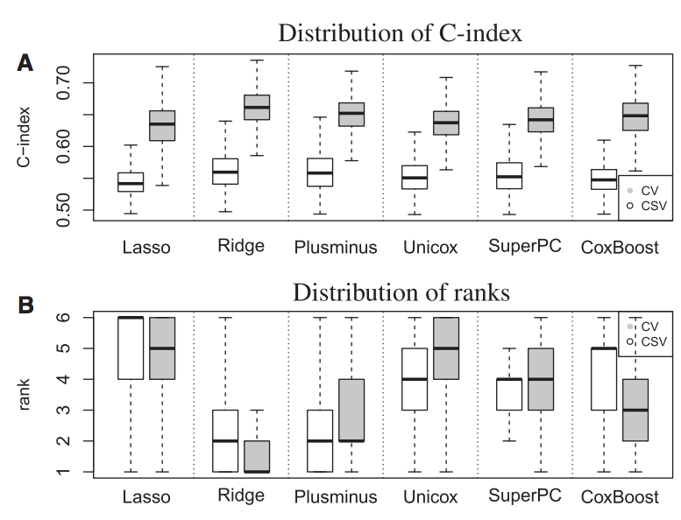
CSV compared to CV in breast cancer
1000 simulations of 8 datasets
median CV, CSV
Specialists?
Generalists?
Bernau, C. et al. Cross-study validation for the assessment of prediction algorithms.
Bioinformatics 30, i105–i112 (2014).
Notes:
Lasso, Ridge, Coxboost have specialist tendencies

Slide 11
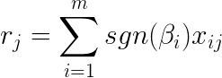
Ma ́s-o-menos: in search of a “generalist” algorithm
Perform univariate regressions
Generate a risk score from coefficient signs:
Formalized an old idea, evaluated theoretically, in simulations
bladder, breast, and ovarian cancers
27 independent microarray studies, 3,833 patients with survival outcomes.
Zhao, S. D. et al. Más-o-menos: A simple sign averaging method for discrimination in genomic data analysis. Bioinformatics 30, 3062–3069 (2014).
Notes:
r_j=\sum_{i=1}^{m}sgn(\beta_i)x_{ij}

Slide 12
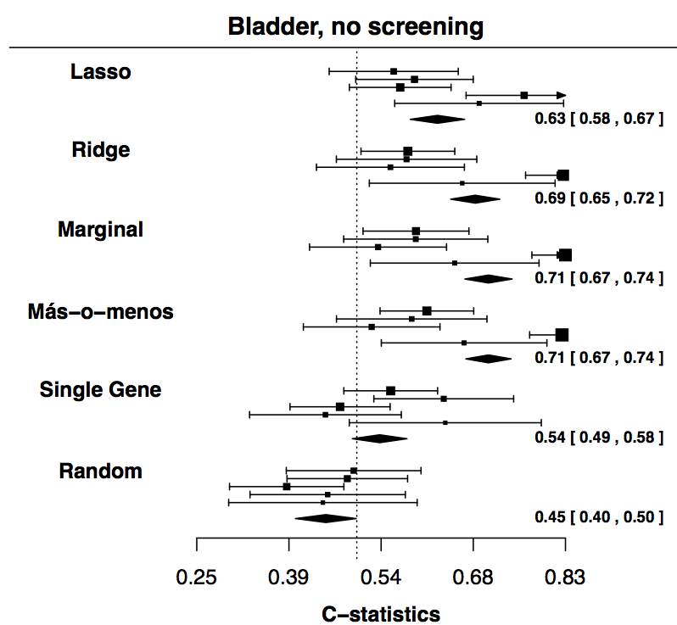
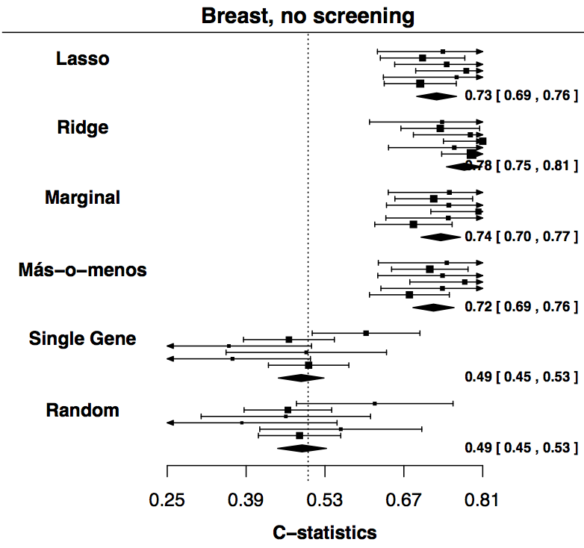
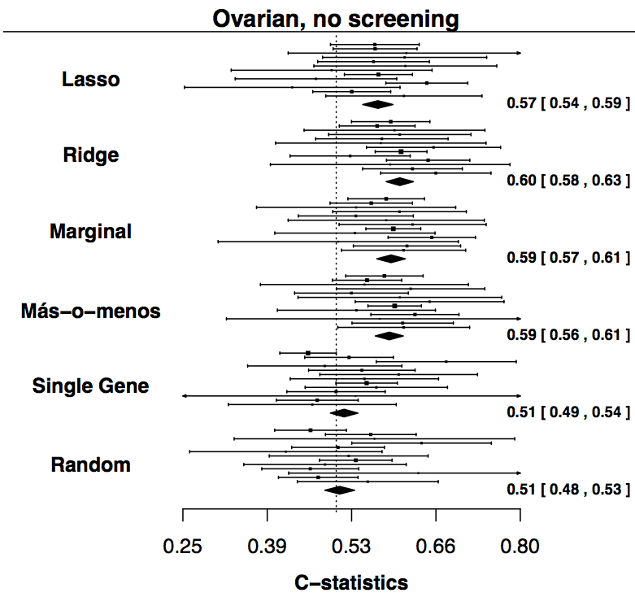
Ma ́s-o-menos: in search of a “generalist” algorithm
Zhao, S. D. et al. Más-o-menos: A simple sign averaging method for discrimination in genomic data analysis. Bioinformatics 30, 3062–3069 (2014).
Notes:
r_j=\sum_{i=1}^{m}sgn(\beta_i)x_{ij}

Slide 13
Bayesian Nonparametric Cross-Study Validation of Prediction Methods
Model latent partitions in Z-matrix with a Dirichlet Process prior
Infer clusters of studies and rank prediction algorithms accounting for heterogeneous studies
Trippa L, Waldron L, Huttenhower C, Parmigiani G. Annals of Applied Statistics 2015, 9(1) 402-428.

Slide 14
What kinds of heterogeneity cause loss of accuracy?
Many studies have noted potential sources of heterogeneity in genomic studies
None have systematically investigated their impacts on prediction accuracy across studies
Zhang Y, Bernau C, Parmigiani G, Waldron L. The impact of different sources of heterogeneity on loss of accuracy from genomic prediction models. bioRxiv 374355 (July 23, 2018)

Slide 15
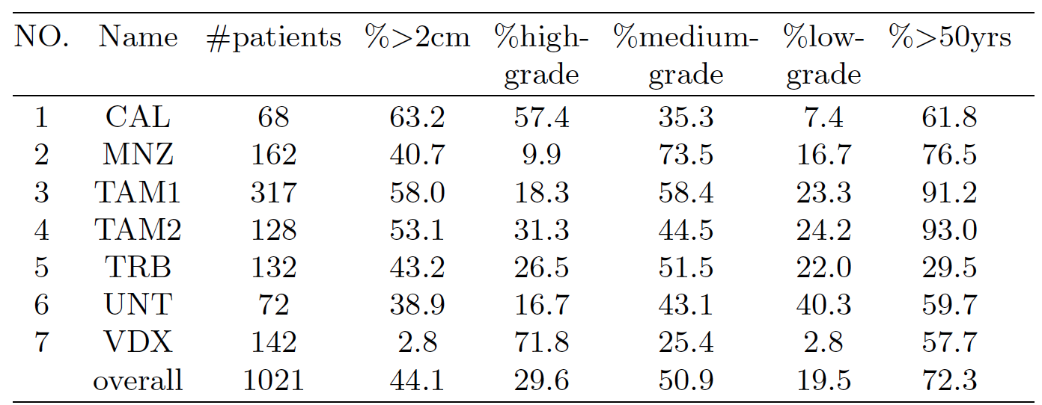
What kinds of heterogeneity cause loss of accuracy?
Three types of heterogeneity between studies are manipulated and studied:
imbalances in the prevalence of clinical and pathological covariates
Manipulate re-sampling probabilities to produce identical joint probability distributions of clinical covariates across datasets

Slide 16
What kinds of heterogeneity cause loss of accuracy?
Three types of heterogeneity between studies are manipulated and studied:
differences in gene covariance due to batch, platform, or tumor purity effects
Filter genes with low Integrative Correlation¹
¹Parmigiani et al. (2004, 1 May). A cross-study comparison of gene expression studies for the molecular classification of lung cancer. Clin. Cancer Res. 10(9), 2922{2927.

Slide 17
What kinds of heterogeneity cause loss of accuracy?
Three types of heterogeneity between studies are manipulated and studied:
residual confounding or other reasons for different “true" models between gene expression / clinical factors and outcome.
Use identical generative models for every dataset

Slide 18
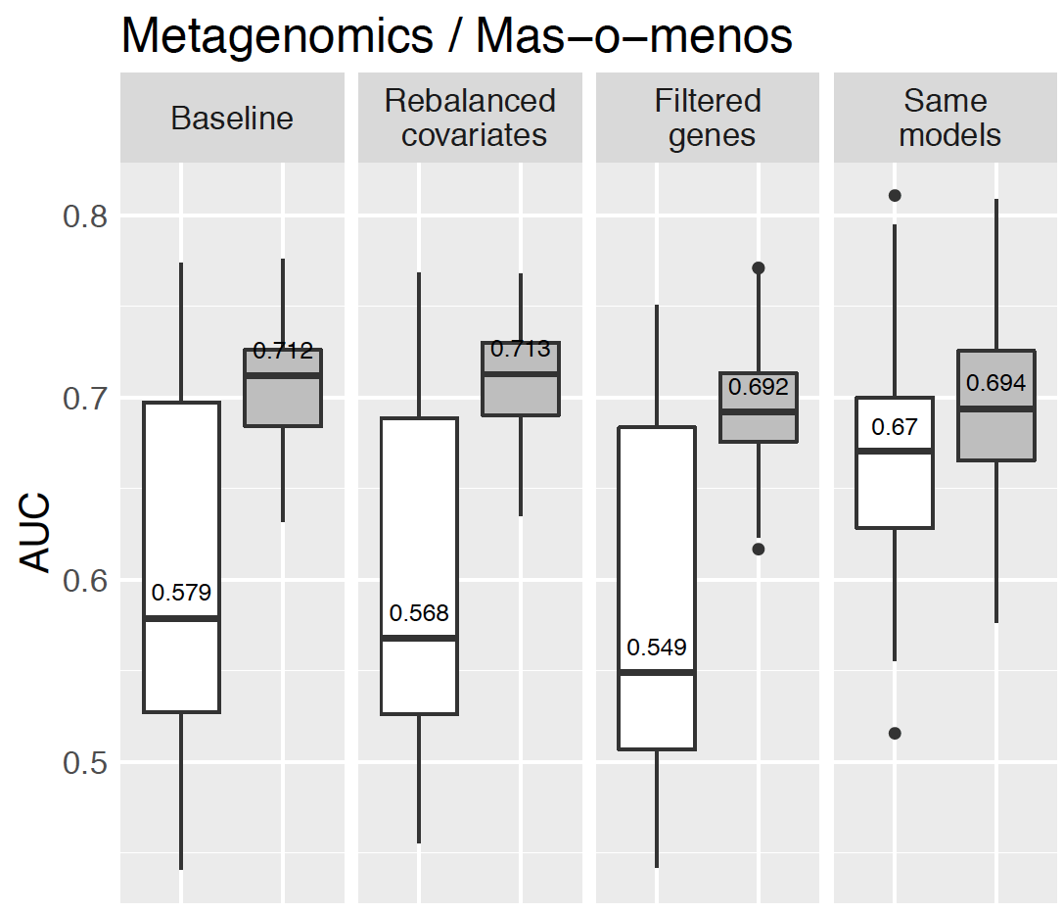
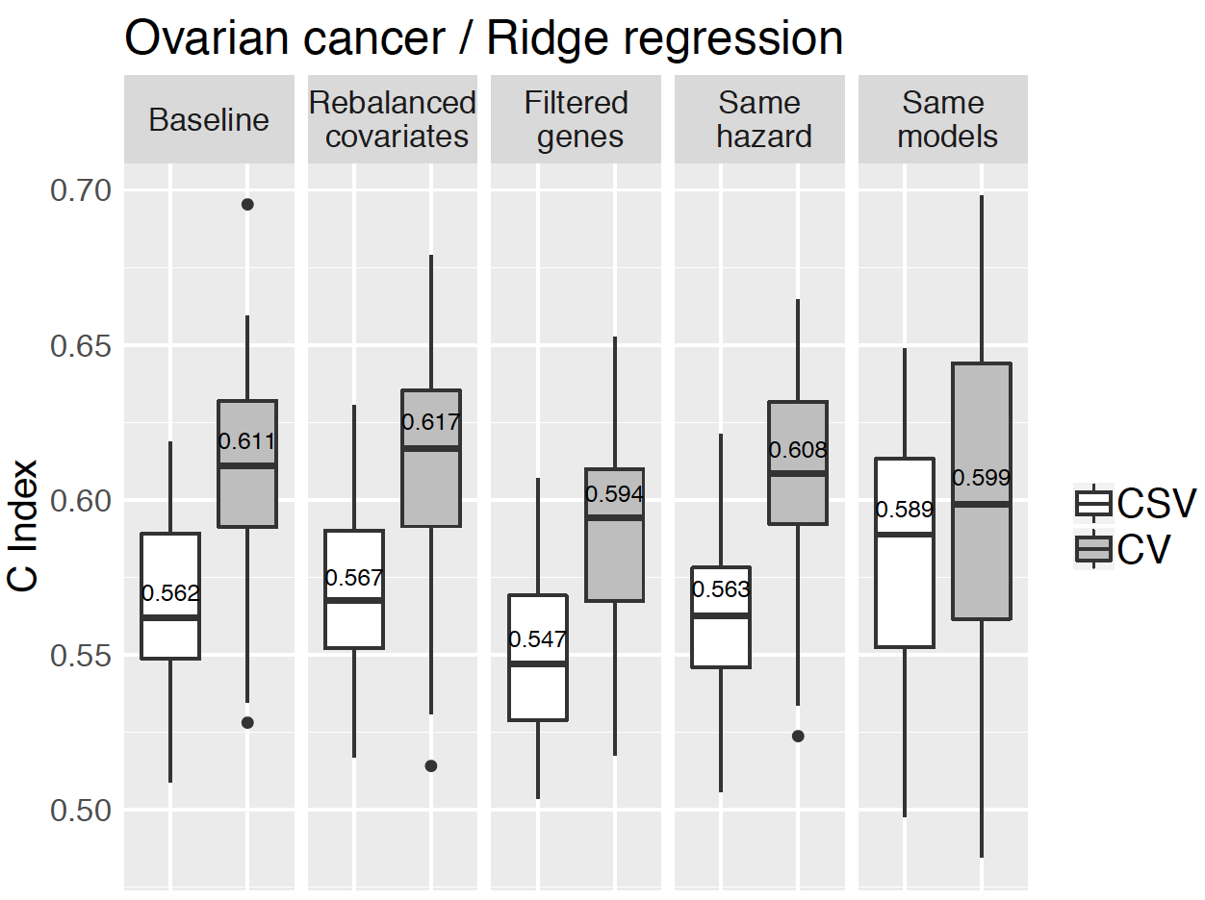
What causes degradation in CSV?
Simulation results comparing performances of cross-validation and cross-study validation.

Slide 19
Conclusions
Easily identifiable sources of heterogeneity are not necessarily the most important ones
Unidentified heterogeneity, such as from unmeasured confounding, may be more important
Zhang Y, Bernau C, Parmigiani G, Waldron L. The impact of different sources of heterogeneity on loss of accuracy from genomic prediction models. bioRxiv 374355 (July 23, 2018)

Slide 20
Future outlook
Increase the amount of usable data
Account for the residual CV/CSV gap
Extension of .632 for two-step fully non-parametric bootstrap
Other validation metrics (PPV/NPV)
Accounting for heterogeneity in CV

Slide 21
Future outlook
Encourage more research in this area through user-friendly R/Bioconductor data packages:
curatedOvarianData
30 datasets, most annotated for OS, surgical debulking, histology
curatedCRCData
34 datasets, many annotated for MSS, gender, stage, age, N, M
curatedBladderData
12 datasets, many annotated for stage, grade, OS
curatedMetagenomicData
30 datasets of microbiome abundance and metabolic function
many annotated for age, BMI, sex, disease
HMP16SData
Painless access to The Human Microbiome Project
simulatorZ: easy simulations based on these data packages

Slide 22
Thank you
Lab members:
Lavanya Kannan, Marcel Ramos, Lucas Schiffer, Chloe Mirzayi, Sehyun Oh, Christoph Bernau, Yuqing Zhang
Collaborators
Giovanni Parmigiani and Lorenzo Trippa (DFCI)
Nicola Segata, Alessandro Quattrone (UNITN)
Michael Birrer (UA Comprehensive Cancer Center)
Bioconductor: Martin Morgan, Vincent Carey, Kasper Hansen
Notes:
met Jin Xu from East China Normal University, Shanghai

Slide 23
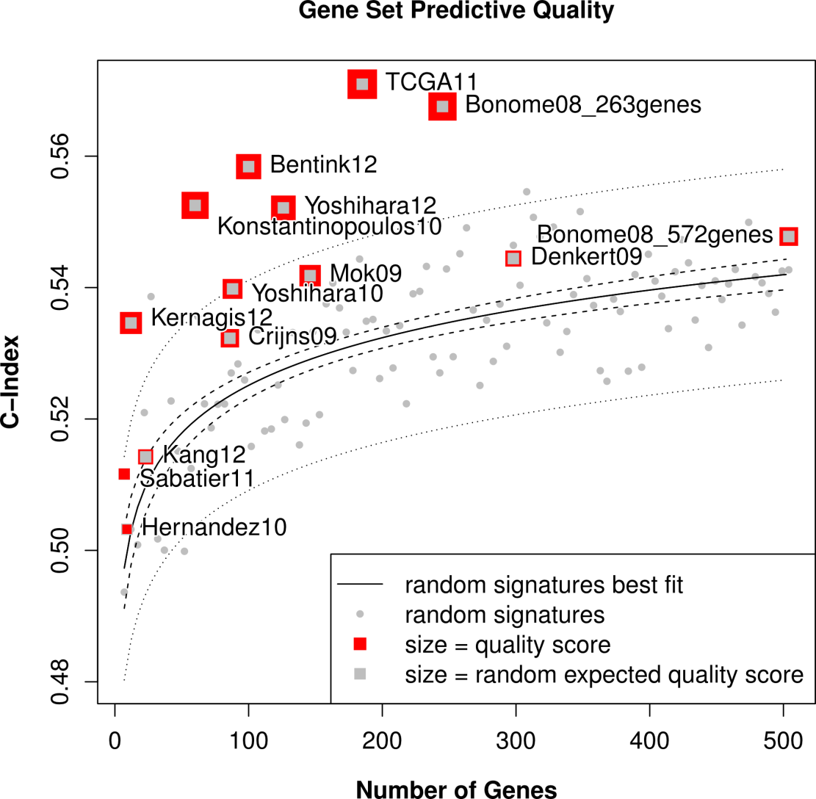
Assessment of gene signatures
About half of gene signatures provide prognostic “value added” over 97.5% of gene random signatures
Waldron L et al. JNCI J Natl Cancer Inst 2014;jnci.dju049
Notes:
What I show here is the mean C-statistic across all combinations of training and independent validation sets, as a function of the number of genes in the signature.

Slide 24
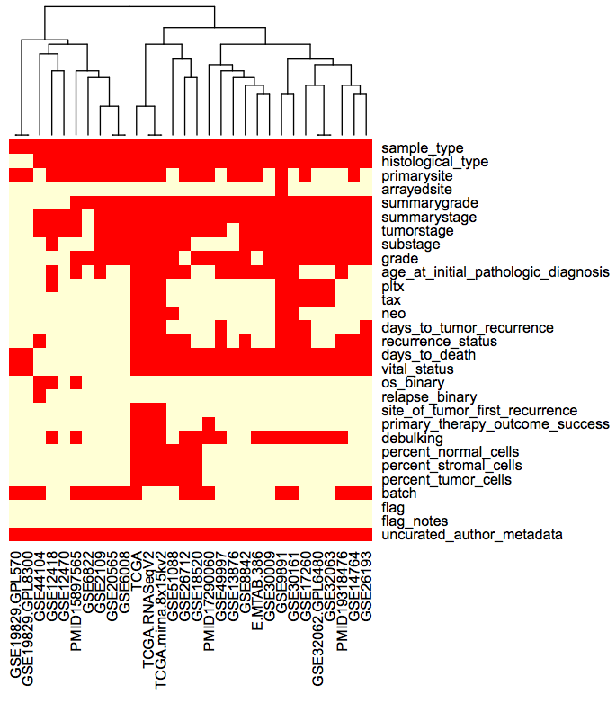
Requirement: curated independent studies
curatedOvarianData Bioconductor package
30 datasets, > 3,000 unique samples
B.F. Ganzfried, M. Riester, B. Haibe-Kains, T. Risch, S. Tyekucheva, I. Jazic, X. V. Wang, M. Ahmadifar, M. Birrer, G. Parmigiani, C. Huttenhower, L. Waldron. curatedOvarianData: Clinically Annotated Data for the Ovarian Cancer Transcriptome. DATABASE: the journal of biological databases and curation (2013).

